Slide 1


HR RAG ASSISTANT
AI-POWERED HR POLICY CHATBOT
HIMA VAISHNAVI

Slide 2


INTRODUCTION
In modern organizations, employees frequently require quick access to HR-related information such as leave policies, payroll details, work-from-home rules, reimbursement procedures, and grievance policies.
However, traditional HR systems often rely on lengthy documents or manual HR support, making the process slow and inefficient.
To address this challenge, the HR RAG Assistant was developed as an AI-powered chatbot capable of understanding employee queries, retrieving relevant HR policies, and generating intelligent, context-aware responses instantly.

Slide 3
Difficulty Accessing HR Information
01
Employees often find it difficult to locate important HR policies because the information is stored in lengthy documents and scattered resources. Searching manually for relevant details takes time and reduces productivity.
PROBLEM STATEMENT
Difficulty Accessing HR Information
Repetitive Workload for HR Teams
02
HR departments frequently handle repeated employee queries related to leave policies, payroll, attendance, and company rules. Answering the same questions multiple times increases workload and consumes valuable time.
Employees often face difficulty finding accurate HR policy information quickly because traditional HR systems rely on lengthy documents and manual support. This process is time-consuming and leads to delays in resolving employee queries. At the same time, HR teams spend a lot of time answering repetitive questions, reducing overall efficiency.
Lack of Intelligent Search Support
03
Traditional search systems are unable to understand the actual intent behind employee queries. As a result, users may receive irrelevant or inaccurate information instead of precise and context-aware responses.

Slide 4
01
INTELLIGENT HR CHATBOT
The HR RAG Assistant acts as an intelligent virtual HR assistant that helps employees access HR-related information quickly and easily. Users can ask questions in a conversational format, and the chatbot provides instant responses related to leave policies, payroll, attendance, work-from-home guidelines, and other HR topics.
OUR SOLUTION
02
FAST POLICY RETRIEVAL
To overcome these challenges, the HR RAG Assistant was developed as an AI-powered chatbot system that provides instant and intelligent HR support. The system uses Retrieval-Augmented Generation (RAG) to retrieve relevant HR policy information and generate accurate, context-aware responses for employee queries.
The system uses advanced retrieval techniques and FAISS vector search to efficiently search through HR policy documents and retrieve the most relevant information within seconds. Instead of manually browsing lengthy documents,
03
CONTEXT-AWARE RESPONSES
Unlike traditional search systems that rely only on keywords, the HR RAG Assistant understands the intent and context behind employee queries. It analyzes the user’s question and generates accurate, meaningful, and relevant responses based on the retrieved HR policy information, ensuring better accuracy and user satisfaction.

Slide 5
01
02
TARGET AUDIENCE
Employees can instantly access HR policies,
leave balances, attendance rules, salary
details, and holiday information through
the chatbot interface.
HR teams can reduce repetitive work by
automating common employee queries and
providing faster policy support.
The HR RAG Assistant is designed for employees,
HR departments, managers, and remote workers
who require quick access to company policies,
leave information, attendance rules, payroll
details, and other HR-related information.
The system improves communication, reduces
manual HR workload, and provides instant
AI-powered support within the organization.
03
04
Managers can use the system to guide team
members regarding work-from-home policies,
attendance, approvals, and company rules.
Remote workers can quickly access HR
guidelines, reimbursement policies,
VPN usage rules, and remote work support.

Slide 6
SYSTEM ARCHITECTURE
Document Pipeline
Query Pipeline
HR Documents
(PDF, DOCX, Excel)
User Question
Data Ingestion
Flask Chatbot UI
Text Extraction
Convert Query to Embedding
Embeddings Creation
Search in FAISS
FAISS Index Storage
Retrieve Similar Policies
Generate Final Response
Display Answer

Slide 7
TECHNOLOGIES USED
Python
Flask
HTML/CSS/JS
FAISS
Sentence Transformers
Watchdog
Ngrok

Slide 8
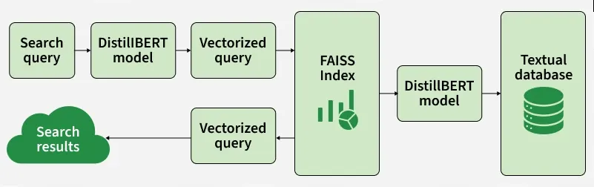
FAISS
(FACEBOOK AI SIMILARITY SEARCH)
FAISS stands for Facebook AI Similarity Search.
Developed by Meta AI Research.
It is a library used for fast similarity search and vector search.

Slide 9
WATCHDOG AUTOMATION
Watchdog monitors the uploads folder continuously.
Detects newly added HR documents automatically.
Triggers document processing instantly.
Reduces manual effort.
Keeps HR knowledge base updated in real time.
Workflow:
Upload File → Watchdog Detects → Text Extraction → Embeddings → FAISS Update

Slide 10
ADVANTAGES
Saves HR team time
Faster employee support
Easy policy access
Accurate responses
Reduces manual searching
Scalable architecture
User-friendly interface

Slide 11
CHALLENGES
Extracting text from different file formats
Handling large HR documents
Improving retrieval accuracy
Managing embeddings efficiently
Designing responsive UI

Slide 12
FUTURE ENHANCEMENTS
Voice-enabled HR assistant
Multi-language support
Employee authentication
Cloud deployment
GPT-based answer generation
Admin dashboard
Database integration

Slide 13
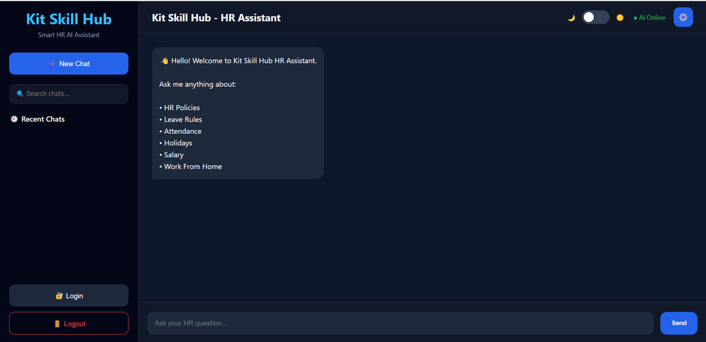
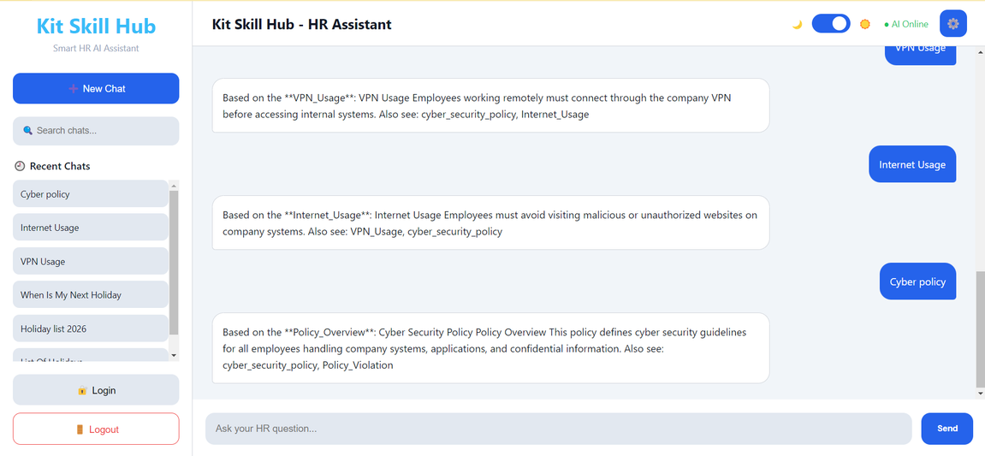
SCREENSHOTS

Slide 14
SCREENSHOTS

Slide 15
CONCLUSION
The HR RAG Assistant successfully automates HR policy retrieval using AI, FAISS, and Retrieval-Augmented Generation, providing fast, accurate, and context-aware responses through a modern chatbot interface.

Slide 16
THANK YOU
VERY MUCH

